Slide 1
Analyzing Health Equity Using Household Survey Data
Lecture 18
Catastrophic Payments for Health Care
“Analyzing Health Equity Using Household Survey Data” Owen O’Donnell, Eddy van Doorslaer, Adam Wagstaff and Magnus Lindelow, The World Bank, Washington DC, 2008, www.worldbank.org/analyzinghealthequity
Notes:
1. Health care finance in low-income countries is still characterized by the dominance of out-of-pocket payments and the relative lack of prepayment mechanisms, such as tax and health insurance. Households without full health insurance coverage face a risk of incurring large medical care expenditures should they fall ill. This uninsured risk reduces welfare. Further, should a household member fall ill, the out-of-pocket purchase of medical care would disrupt the material living standards of the household. If the health care expenses are large relative to the resources available to the household, this disruption to living standards may be considered catastrophic. One conception of fairness in health finance is that households should be protected against such catastrophic medical expenses (World Health Organization 2000).

Slide 2
What are catastrophic payments?
Worldwide interest in fairness in health financing
One aspect is financial protection against “catastrophic” impact of health costs on household welfare
Ideally would use longitudinal data to identify this impact
With cross-section data, a high OOP payments budget share has been used as a proxy indicator of catastrophic impact
Idea is that such high spending implies an excessive opportunity cost of other consumption in short or long term
But overlooks health impact on individuals that forgo medical care because cannot afford to pay
Also does not take account of earnings losses due to illness
So, approach is incomplete, but nonetheless informative
“Analyzing Health Equity Using Household Survey Data” Owen O’Donnell, Eddy van Doorslaer, Adam Wagstaff and Magnus Lindelow, The World Bank, Washington DC, 2008, www.worldbank.org/analyzinghealthequity
Notes:
1. Ideally, longitudinal data would be used to estimate the extent to which living standards are seriously disrupted by the purchase of medical care in response to illness shocks. That would allow one to identify how spending on nonmedical goods and services changes following some health shock (Gertler and Gruber 2002; Wagstaff 2006). But often only cross-section data are available. Some approximation to the disruptive effect of health expenditures on material living standards must then be made. A popular approach has been to define medical spending as “catastrophic” if it exceeds some fraction of household income or total expenditure in a given period, usually one year (Berki 1986; Russell 2004; Wagstaff and van Doorslaer 2003; Wyszewianski 1986; Xu et al. 2003). The idea is that spending a large fraction of the household budget on health care must be at the expense of the consumption of other goods and services. This opportunity cost may be incurred in the short term if health care is financed by cutting back on current consumption or in the long term if it is financed through savings, the sale of assets, or credit. With cross-section data, it is difficult to distinguish between the two. Besides this, there are other limitations of the approach. First, it identifies only the households that incur catastrophic medical expenditures and ignores those that cannot meet these expenses and so forgo treatment. Through the subsequent deterioration of health, such households probably suffer a greater welfare loss than those incurring catastrophic payments. Recognizing this, Pradhan and Prescott (2002) estimate exposure to, rather than incurrence of, catastrophic payments. Second, in addition to medical spending, illness shocks have catastrophic economic consequences through lost earnings. Gertler and Gruber (2002) find that in Indonesia earnings losses are more important than medical spending in disrupting household living standards following a health shock. Notwithstanding these limitations, medical spending in excess of a substantial fraction of the household budget is informative of at least part of the catastrophic economic consequences of illness, without fully identifying the welfare loss from lack of financing protection against health shocks.

Slide 3
Catastrophic payments – a definition
Ethical position: No one should have to spend in excess of a given fraction of his resources on health care
Defined in terms of ratio of OOP payments to measure of household resources
Ideally, take account of how health care financed and define in terms of payments at expense of current consumption relative to current income
But data on means of finance usually not available
Then define by OOP payments budget share
To allow for low non-discretionary spending of poor, may define relative to food, rather than total, expenditure
“Analyzing Health Equity Using Household Survey Data” Owen O’Donnell, Eddy van Doorslaer, Adam Wagstaff and Magnus Lindelow, The World Bank, Washington DC, 2008, www.worldbank.org/analyzinghealthequity
Notes:
On second point see Flores et al (2008) Health Economics, forthcoming.
If total household expenditure is used as the denominator, the catastrophic payments are defined in relation to the health payments budget share. A potential problem is that this budget share may be low for poor households in low-income countries. The severity of the budget constraint means that most resources are absorbed by items essential to sustenance, such as food, leaving little to spend on health care. This derives from the first limitation of the catastrophic payments approach identified above. Households that cannot afford to meet catastrophic payments are ignored. A partial solution is to define catastrophic payments not with respect to the health payments budget share but with respect to health payments as a share of expenditure net of spending on basic necessities. The latter has been referred to as “nondiscretionary expenditure” (Wagstaff and van Doorslaer 2003) or “capacity to pay” (Xu et al. 2003). The difficulty lies in the definition of expenditure that is nondiscretionary. A common approach is to use household expenditure net of food spending as an indicator of living standards. Of course, not all food purchases are nondiscretionary. But nonfood expenditure may better distinguish between the rich and the poor than does total expenditure.

Slide 4
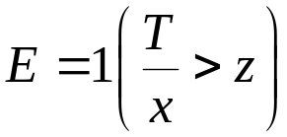
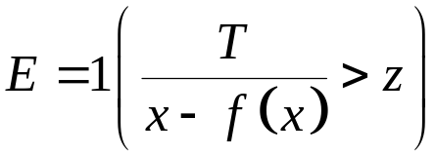
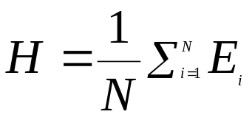
Measuring incidence of catastrophic payments
Catastrophic payments incurred if
or
where T is OOP payments, x total expenditure,
f(x) food exp. and z some threshold
The value of z is subjective; it should vary depending if x or x-f(x) is the denominator
The catastrophic payments headcount is
“Analyzing Health Equity Using Household Survey Data” Owen O’Donnell, Eddy van Doorslaer, Adam Wagstaff and Magnus Lindelow, The World Bank, Washington DC, 2008, www.worldbank.org/analyzinghealthequity
Notes:
1. Measures of the incidence and intensity of catastrophic payments can be defined analogous to those for poverty. The incidence of catastrophic payments can be estimated from the fraction of a sample with health care costs as a share of total (or nonfood) expenditure exceeding the chosen threshold.

Slide 5

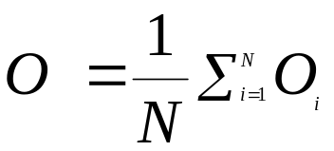
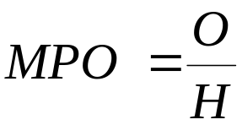
Intensity of catastrophic payments
Household catastrophic payments overshoot:
Catastrophic payments overshoot:
Mean positive overshoot:
  Reflects both incidence and intensity
“Analyzing Health Equity Using Household Survey Data” Owen O’Donnell, Eddy van Doorslaer, Adam Wagstaff and Magnus Lindelow, The World Bank, Washington DC, 2008, www.worldbank.org/analyzinghealthequity

Slide 6
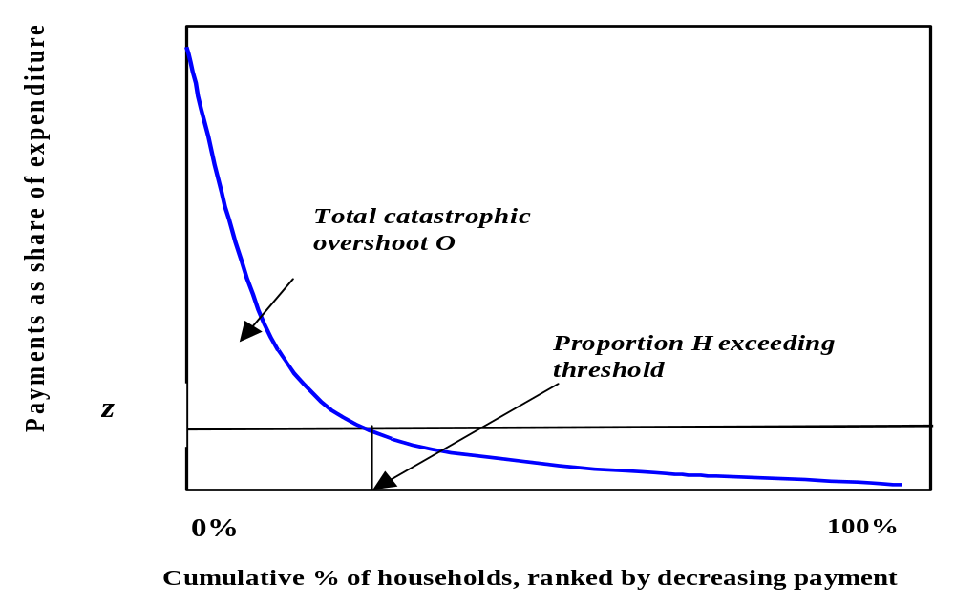
Incidence and intensity of catastrophic payments
Health Payments Budget Share against Cumulative
Percent of Households Ranked by Decreasing Budget Share
Notes:
The horizontal axis in figure 18.1 shows the cumulative fraction of households ordered by the ratio T/x from largest to smallest.[1] Reading off this graph at the threshold z, one obtains the fraction H of households with health care budget shares that exceed the threshold z. This is the catastrophic payment head count.
The figure is basically the cumulative density function for the reciprocal of the health payments budget share with the axes reversed.
In the figure, O is indicated by the area under the payment share curve but above the threshold level.

Slide 7
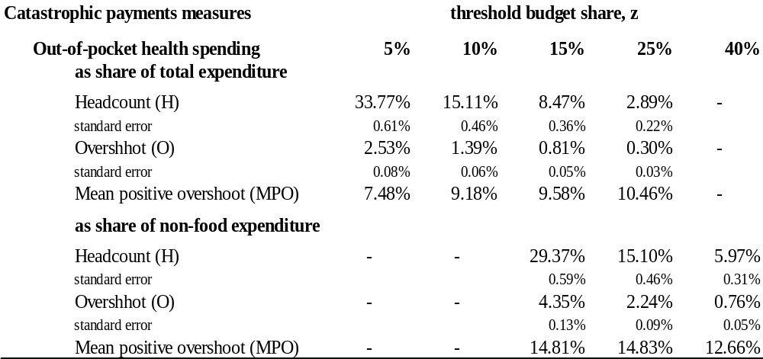
Catastrophic health care payments in Vietnam, 1998
“Analyzing Health Equity Using Household Survey Data” Owen O’Donnell, Eddy van Doorslaer, Adam Wagstaff and Magnus Lindelow, The World Bank, Washington DC, 2008, www.worldbank.org/analyzinghealthequity
Notes:
1. The table below presents measures of the incidence and intensity of catastrophic payments for health care in Vietnam estimated from the 1998 Vietnam Living Standards Survey. Catastrophic payments are defined for health payments as a share of both total household expenditure and nonfood expenditure, using various threshold budget shares. As the threshold is raised from 5 percent to 25 percent of total expenditure, the estimate of the incidence of catastrophic payments (H) falls from 33.8 percent to 2.9 percent, and the mean overshoot drops from 2.5 percent of expenditure to only 0.3 percent. Standard errors are small relative to the point estimates, which is to be expected for a reasonable sample size (5,999 in this case). Unlike the head count and the overshoot, the mean overshoot among those exceeding the threshold (MPO) need not decline as the threshold is raised. Those spending more than 5 percent of total expenditure on health care, on average spent 12.5 percent (5% + 7.48%). Those spending more than 25 percent of the household budget on health care, on average spent 35.5 percent.

Slide 8
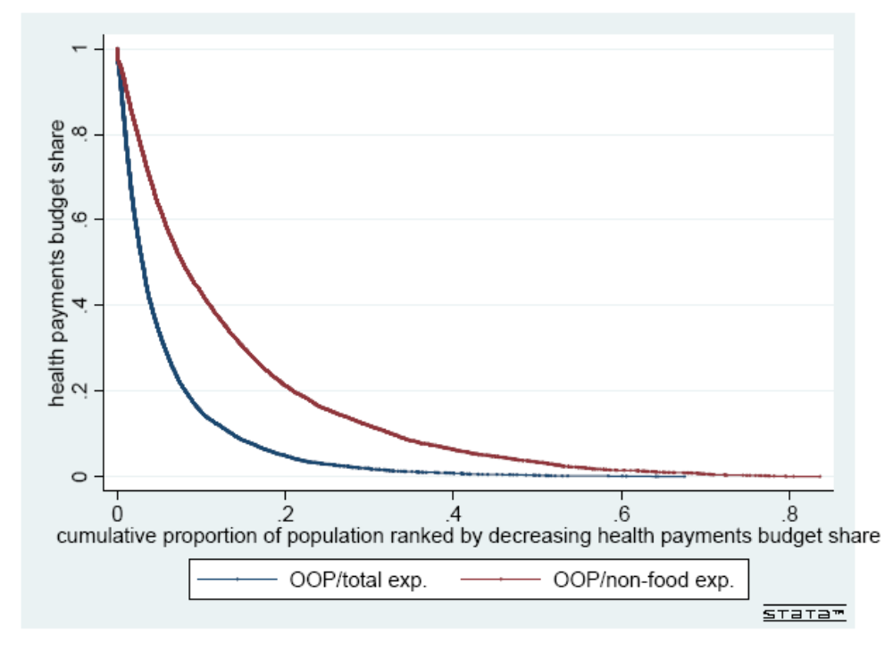
Health payments budget share distributions in Vietnam, 1998
Health Payments Total and Nonfood Budget Share against
Cumulative % of Households Ranked by Decreasing Budget Share
Notes:
1. For a given threshold, both the head count and the overshoot are higher, as they must be, when catastrophic payments are defined with respect to health payment relative to nonfood expenditure. This is also illustrated graphically in the figure, which shows the health budget share curves for both definitions. For any budget share, the OOP/[nonfood exp.] curve is always to the right of the OOP/[total exp.] curve. For instance, for more than 15 percent of households, health spending was at least a quarter of nonfood expenditure, but health spending was a quarter of total expenditure for only 3 percent of households.

Slide 9
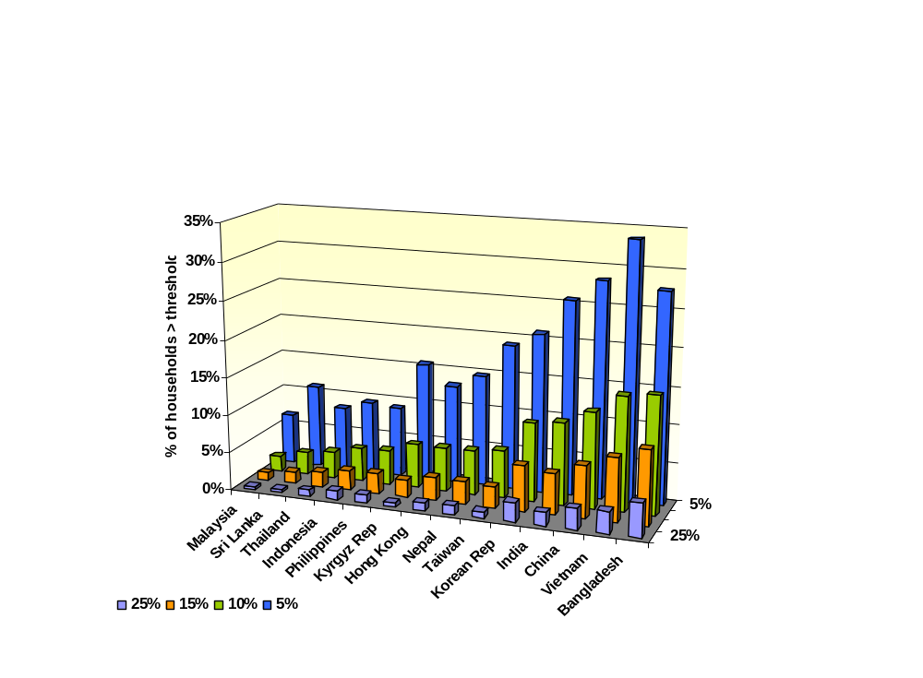
Catastrophic payments headcounts in Asia
“Analyzing Health Equity Using Household Survey Data” Owen O’Donnell, Eddy van Doorslaer, Adam Wagstaff and Magnus Lindelow, The World Bank, Washington DC, 2008, www.worldbank.org/analyzinghealthequity
Notes:
1. Van Doorslaer, O’Donnell et al (2007) Catastrophic Payments in Asia. Health Economics.

Slide 10
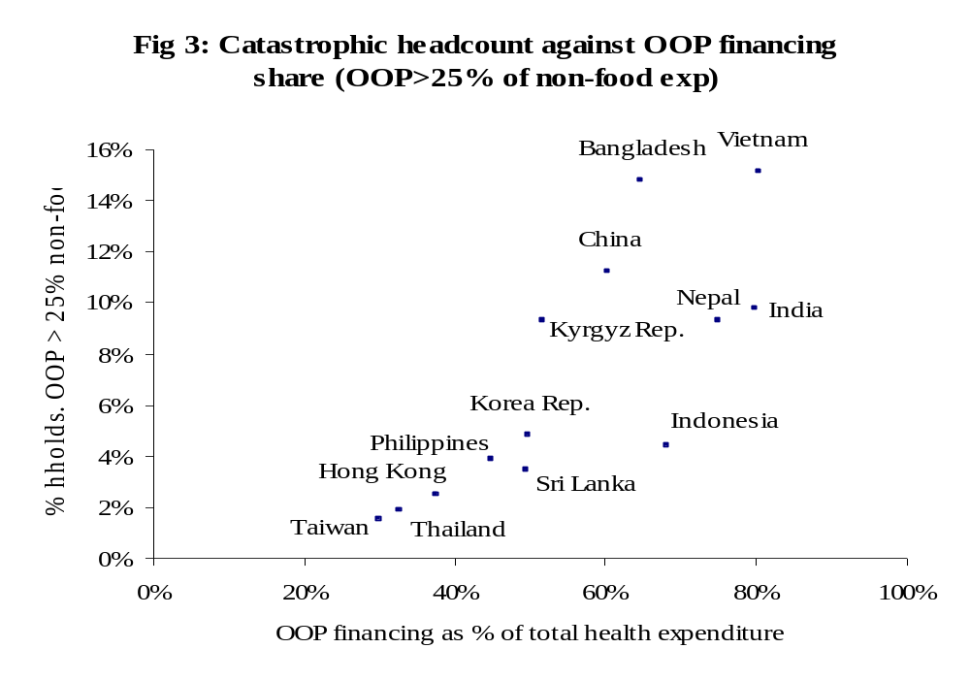
“Analyzing Health Equity Using Household Survey Data” Owen O’Donnell, Eddy van Doorslaer, Adam Wagstaff and Magnus Lindelow, The World Bank, Washington DC, 2008, www.worldbank.org/analyzinghealthequity
Notes:
It is clear that countries that rely more on OOP financing have a larger incidence of catastrophic payments. Of course, that is to be expected.
The pattern is the same for different thresholds and using total exp rather than food exp as the denominator.

Slide 11
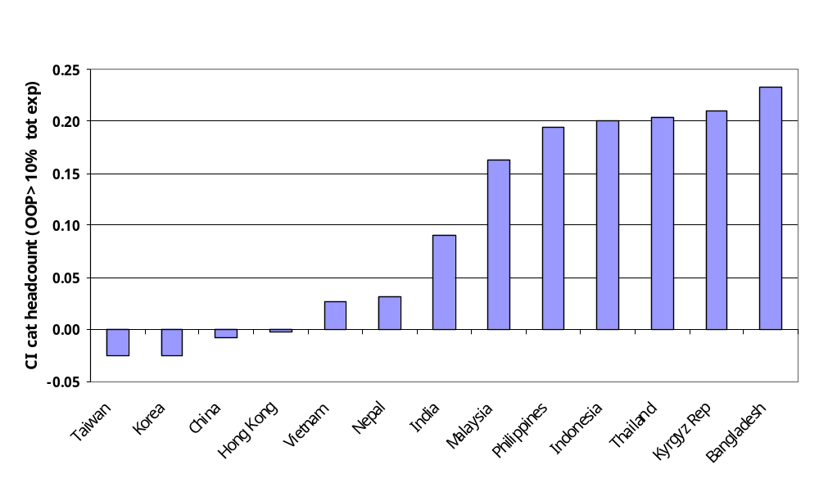
Incidence of catastrophic payments is higher among the better-off in low-income countries
Concentration index for the catastrophic payment headcount
defined as OOP > 10% of total expenditure
“Analyzing Health Equity Using Household Survey Data” Owen O’Donnell, Eddy van Doorslaer, Adam Wagstaff and Magnus Lindelow, The World Bank, Washington DC, 2008, www.worldbank.org/analyzinghealthequity
Notes:
In the lower income countries, that rely more on OOP finance, those households with higher total expenditure are more likely to spend in excess of 10% of this on OOP health payments. In the higher income countries, there is a slight tendency for the less well-off to incur catastrophic payments.
This probably reflects the forgone health care by poor households in low-income countries. They cannot afford to purchase health care and so are less likley to incur catastrophic payments.
In higher income countries, which rely more on pre-payment, there are fewer extremely poor that cannot afford to pay for health care. Then the distribution of OOP payments is more closely correlated with the distribution of illness ie concentrated on the poor.

Slide 12
Explain me this
Given the severity of their budget constraints, the very poor are less likely to incur catastrophic payments in low-income countries
When incurred, catastrophic health expenditures may have a larger impact on the welfare of the very poor
Take into account by weighting catastrophic payments in inverse relation to position in the income distribution
Compute rank-weighted measures of catastrophic payments
Let C_{E} be the concentration index for the indicator of catastrophic payments, E. C_{E} >0 indicates the better-off are more likely to incur catastrophic payments
Rank-weighted headcount: H^{W}=H(1- C_{E}), H^{W<}H if C_{E}>0
Rank-weighted overshoot: O^{W}=O(1- C_{o}), H^{W<}H if C_{O}>0
“Analyzing Health Equity Using Household Survey Data” Owen O’Donnell, Eddy van Doorslaer, Adam Wagstaff and Magnus Lindelow, The World Bank, Washington DC, 2008, www.worldbank.org/analyzinghealthequity
Notes:
As noted above, if health spending is income elastic, nonfood expenditure may be preferred for the denominator of the budget share to better detect catastrophic payments among the poor. But the measures introduced in the previous section are insensitive to the distribution of catastrophic payments. In the head count, all households exceeding the threshold are counted equally. The overshoot counts all dollars spent on health care in excess of the threshold equally, irrespective of whether they are made by the poor or by the rich. If there is diminishing marginal utility of income, the opportunity cost of health spending by the poor will be greater than that by the rich. If one wishes to place a social welfare interpretation on measures of catastrophic payments, then it might be argued that they should be weighted to reflect this differential opportunity cost.
The distribution of catastrophic payments in relation to income could be measured by concentration indices for Ei and Oi. Label these indices CE and CO. A positive value of CE indicates a greater tendency for the better-off to exceed the payment threshold; a negative value indicates that the worse-off are more likely to exceed the threshold. Similarly, a positive value of CO indicates that the overshoot tends to be greater among the better-off. One way of adjusting the head count and overshoot measures of catastrophic payments to take into account the distribution of the payments is to multiply each measure by the complement of the respective concentration index (Wagstaff and van Doorslaer 2003).
The measures imply value judgments about how catastrophic payments incurred by the poor are weighted relative to those incurred by the better-off. The imposition of value judgments is unavoidable in producing any distribution-sensitive measure. In fact, it could be argued that a distribution-insensitive measure itself imposes a value judgment—catastrophic payments are weighed equally irrespective of who incurs them. The particular weighting scheme imposed by equation 18.4 is that the household with the lowest income receives a weight of two, and the weight declines linearly with rank in the income distributions so that the richest household receives a weight of zero. So, if the poorest household incurs catastrophic payments, it is counted twice in the construction of ; whereas if the richest household incurs catastrophic payments, it is not counted at all. A similar interpretation holds for equation 18.5. Obviously, different weighting schemes could be proposed to construct alternatives to these rank-dependent weighted head count and overshoot indices.
If those who exceed the catastrophic payments threshold tend to be poorer, the concentration index CE will be negative, and this will make greater than H. From a social welfare perspective and given the distributional judgments imposed, the catastrophic payment problem is worse than it appears simply by looking at the fraction of the population exceeding the threshold because it overlooks the fact that it tends to be the poor who exceed the threshold. However, if it is the better-off individuals who tend to exceed the threshold, CE will be positive, and H will overstate the problem of the catastrophic payments as measured by .

Slide 13
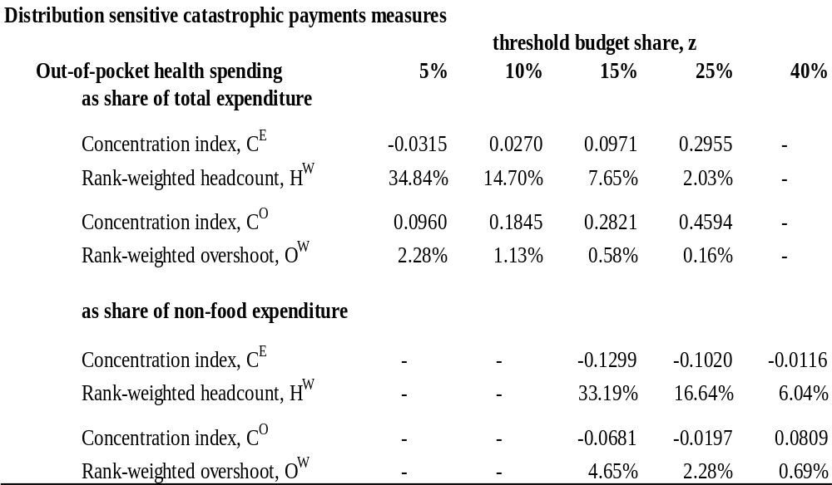
Distribution-Sensitive Catastrophic Payments Measures, Vietnam 1998
“Analyzing Health Equity Using Household Survey Data” Owen O’Donnell, Eddy van Doorslaer, Adam Wagstaff and Magnus Lindelow, The World Bank, Washington DC, 2008, www.worldbank.org/analyzinghealthequity
Notes:
1. In the table below we present the concentration indices and the rank-weighted head count and overshoot measures for the same example of Vietnam. The distribution of catastrophic payments clearly depends on whether health payments are expressed as a share of total expenditure or of nonfood expenditure. In the former case, catastrophic payments rise with total expenditure, with the exception only of the head count at the 5 percent threshold. This reflects the fact that the OOP health payments budget share tends to rise with total household resources in low-income countries (van Doorslaer et al. 2007). As a result, the rank-weighted head count and overshoot are smaller than the unweighted indices given in the table in box 18.1. But when health payments are assessed relative to nonfood expenditure, the concentration indices are negative, with one exception, indicating that the households with low nonfood expenditures are more likely to incur catastrophic payments defined in this way. As a consequence, the weighted indices are larger than the unweighted indices in the table in box 18.1. The difference between the total and nonfood expenditure results is due to the income inelasticity of food expenditures.

Slide 14
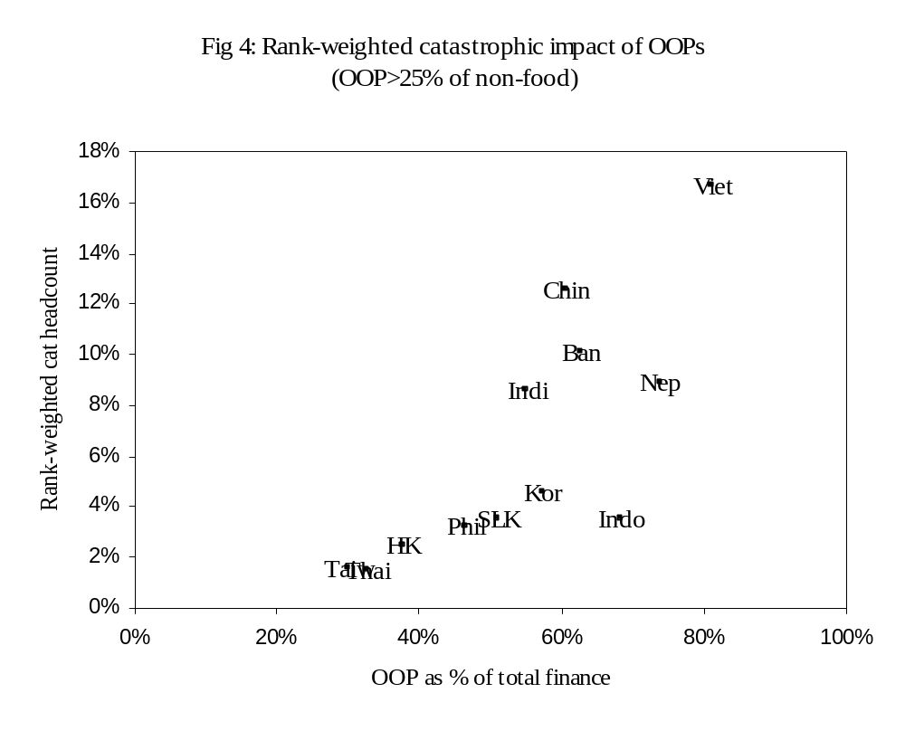
“Analyzing Health Equity Using Household Survey Data” Owen O’Donnell, Eddy van Doorslaer, Adam Wagstaff and Magnus Lindelow, The World Bank, Washington DC, 2008, www.worldbank.org/analyzinghealthequity
Notes:
This is the same as a previous chart but for the fact that the rank-weighted catastrophic headcount is now on the y-axis.
The general pattern is the relationship is the same. But there have been some changes in the relative positions of countries. For example, note that the weighted headcount is higher in China than Bangladesh. The reverse was true for the unweighted headcount. This means that catastrophic payments are more cencentrated on the better-off in Bangladesh than in China.

